Slide 1


Comparing 3D descriptors for local search of craniofacial landmarks
F.M. Sukno^{1,2}, J.L. Waddington² and Paul F. Whelan¹
¹Dublin City University and
²Royal College of Surgeons in Ireland

Slide 2
Objective and Contents
Objective
  To compare the performance of 3D geometry descriptors
    For the accurate localization of facial landmarks
    In a quantitative manner that relates to the localization error
Contents
  Context and descriptors
  Expected local accuracy
    Curves and comparison method
  Results
    Evaluation of 6 geometric descriptors

Slide 3
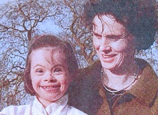
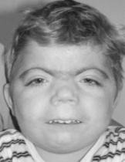
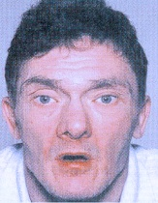
Context
Craniofacial geometry has been suggested as an index of early brain dysmorphogenesis in neuropsychiatric disorders
  Down syndrome
  Autism
  Schizophrenia
  Bipolar disorder
  Fetal alcohol syndrome
  Velocardiofacial syndrome
  Cornelia de Large syndrome
  ...
Shape differences can be subtle
  Need for highly accuracy analysis
Notes:
Interest in facial geometry – craniofacial dysmorphology linked to mental disorders
Deep intimacy of face-brain during early development
Best example: down syndrome, but patterns also in many other disorders

Slide 4
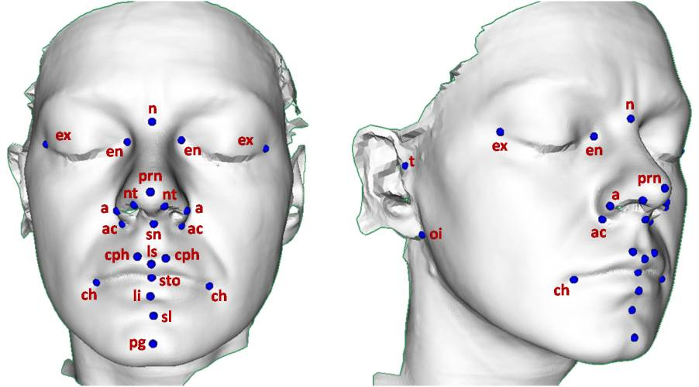
Craniofacial landmarks
Manual annotations from: R. Hennessy et al. Biol Psychiat 51 (2002) 507–514

Slide 5
Evaluated descriptors
Distance-based
  Spin Images (SI)
    A. Johnson et al. IEEE T Pattern Anal 21 (1999) 433–449
  3D Shape Contexts (3DSC)
    A. Frome et al. In: Proc. ECCV (2004) 224–237
  Unique Shape Contexts (USC)
    F. Tombari et al. In: Proc. 3DOR (2010) 57–62
Orientations-based
  Signature of Histograms of Orientations (SHOT)
    F. Tombari et al. In: Proc. ECCV (2010) 356–369
  Point Feature Histograms (PFH)
    R. Rusu et al. In: Proc. IROS (2008) 3384–3391
  Fast Point Feature Histograms (FPFH)
    R. Rusu et al. In: Proc. ICRA (2009) 3212–3217

Slide 6
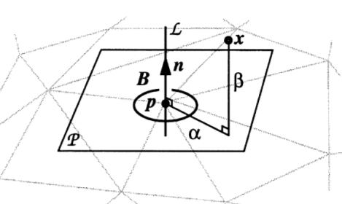
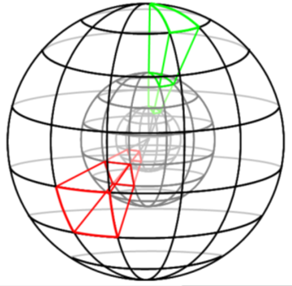
Distance-based descriptors
Spin Images (SI)
  2D histogram of distances
  The normal set the reference
  Rotationally invariant
3D Shape Contexts (3DSC)
  3D histogram (radius, elevation and azimuth)
  The normal sets the reference
  Azimuth uncertainty
Unique Shape Contexts (USC)
  Fully 3D reference system

Slide 7
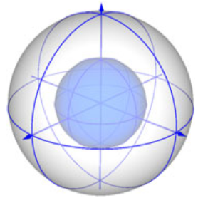
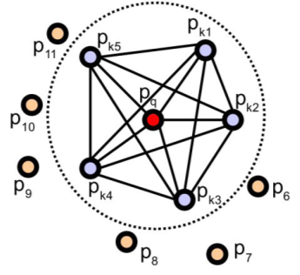
Orientation-based descriptors
Signature of Histograms (SHOT):
  Coarse bin system as 3DSC and USC
  Each bin is described with a histogram of directions (w.r.t. the ref normal).
Point Feature Histograms (PFH):
  3D Histogram of relative orientations of every pair of points in the neighbourhood
  High computational load: O(N²) against O(N) of all other descriptors
Fast Point Feature Histograms (FPFH)
  As PFH but only pairs with the central pt

Slide 8
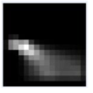
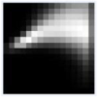
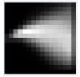
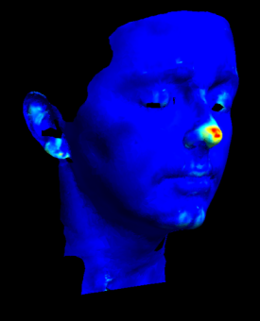
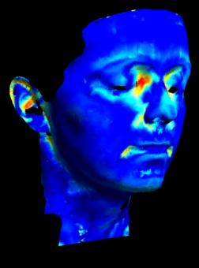
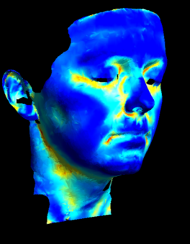
Similarity maps with geometry descriptors
Cross correlation of a template with every mesh vertex
We can generate a colour-coded similarity map
Example of similarity maps using spin images
High similarity
Low similarity
Nose tip
Eye corners
(inner)
Mouth corners

Slide 9
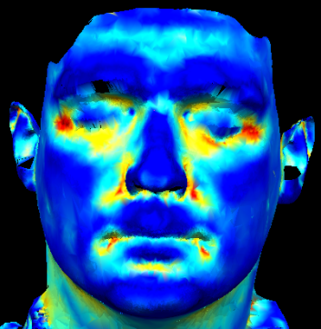
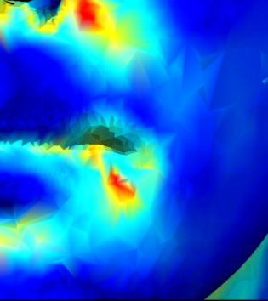
Expected Local Accuracy
Is the expected distance from the vertex obtaining the maximum score to the ground truth position, but only searching on a neighbourhood of radius r
d

Slide 10
Expected Local Accuracy
Is the expected distance from the vertex obtaining the maximum score to the ground truth position, but only searching on a neighbourhood of radius r

Slide 11
Expected Local Accuracy
Is the expected distance from the vertex obtaining the maximum score to the ground truth position, but only searching on a neighbourhood of radius r

Slide 12
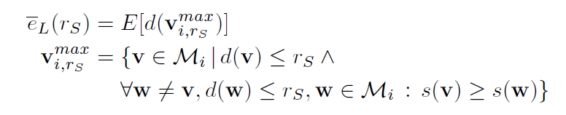
Expected Local Accuracy

Slide 13
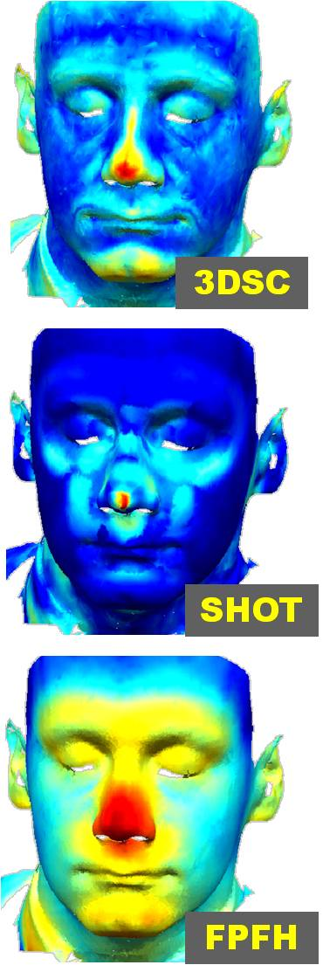
Examples for the nose tip (prn)

Slide 14
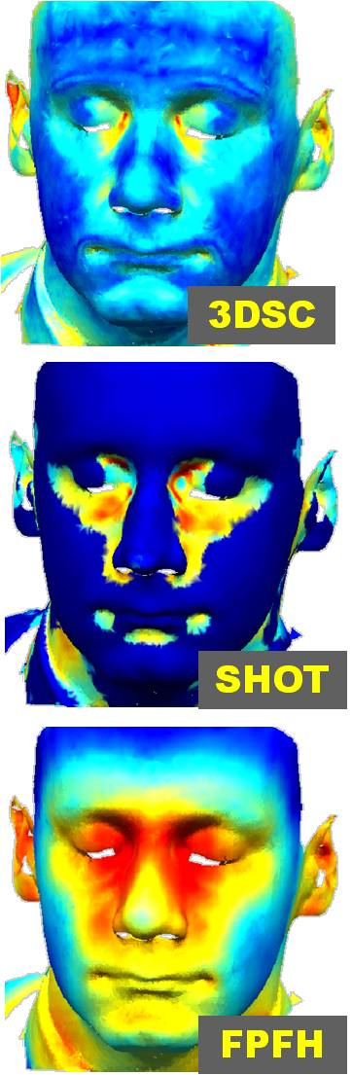
Inner-eye corners (en)

Slide 15
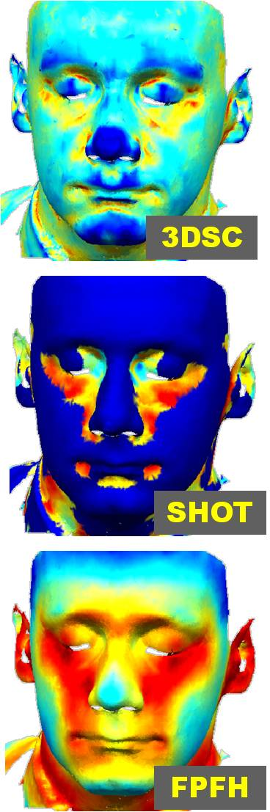
Inferior earlobe (oi)

Slide 16
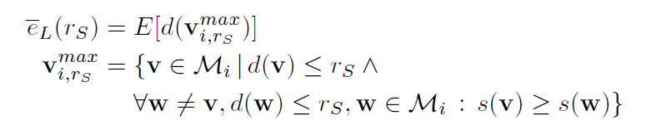
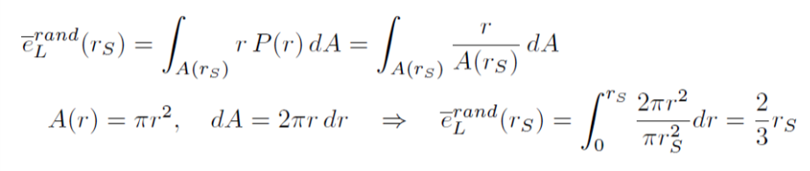
Performance with random choice
From the definition of expected local accuracy:
If we assume a random descriptor (i.e. a uniformly distributed probability density for all points within the search radius):

Slide 17
Expected local accuracy curves

Slide 18
First flat region or plateau
PLATEAU
Value
Limits

Slide 19
Results
Test set of 144 facial scans
  With expert annotations
  Tests using 6-fold cross validation
Results organized in tables
  In each row we compare the 6 descriptors
  The first plateau is used for comparison
    Value and limits (n.p = No Plateau if not present)
  Best descriptor per landmark highlighted in boldface
    No significantly different results from the best are indicated with an asterisk
  Best neighbourhood size indicated by symbols
    20mm (↓), 30mm (–) and 40mm (↑)

Slide 20
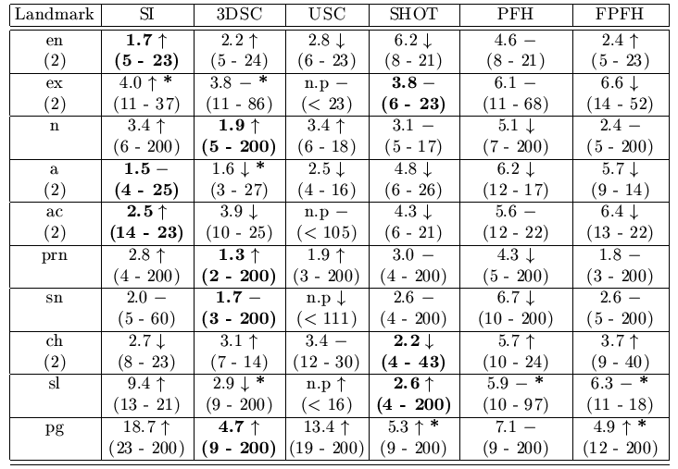
Expected Local Accuracy (1/2)

Slide 21
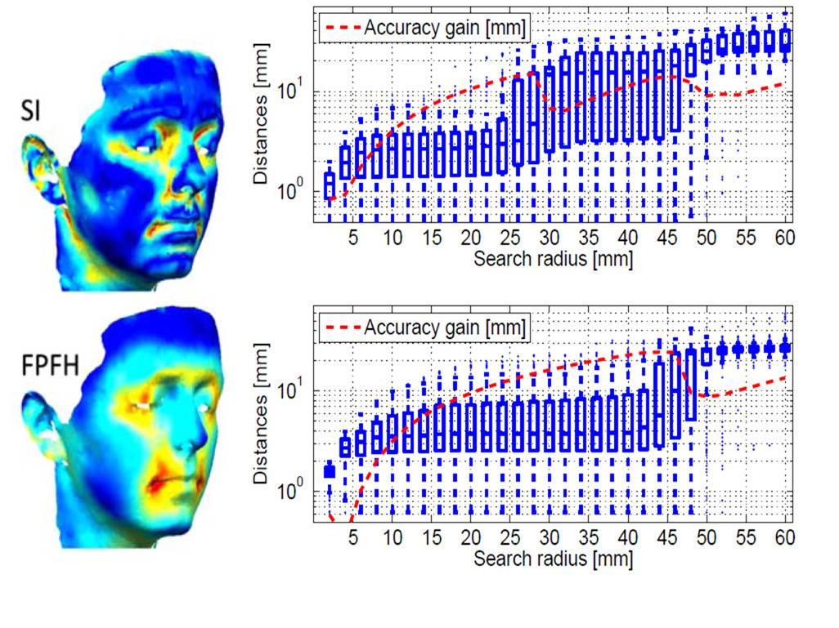

Example: mouth corner (ch)

Slide 22
Best scale: descriptor- and landmark-trends

Slide 23
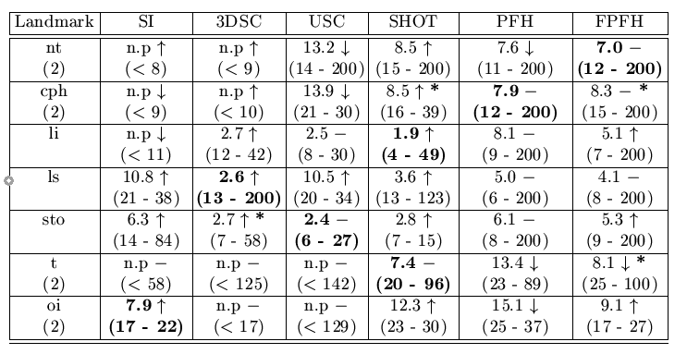
Expected Local Accuracy (2/2)
The full tables are available at http://fsukno.atspace.eu/Research.htm

Slide 24
Conclusive remarks
We present a study of local accuracy to compare geometry descriptors in 3D
  We define expected local accuracy curves
  Good descriptors tend to have a plateau in these curves
  The plateau is identified as the main feature of those curves and it facilitates comparison of the descriptors
We evaluated 6 descriptors
  Performance showed strong dependency on the chosen landmark
  No descriptor clearly dominated over the rest
  3DSC, SI and SHOT achieved better performance than USC, PFH and FPFH

Slide 25


The Face3D project
The project is funded by the Wellcome Trust
The partners in the project are:
The University of Glasgow
Royal College of Surgeons in Ireland
Dublin City University
Institute of Technology, Tralee
University of Limerick
THANK YOU FOR YOUR ATTENTION

